Slide 1
How will TEMPO data improve current research?
Susan Anenberg, PhD
May 4, 2023
TEMPO / GeoXO / TolNet Science Team Meetings
Notes:
15 min

Slide 2

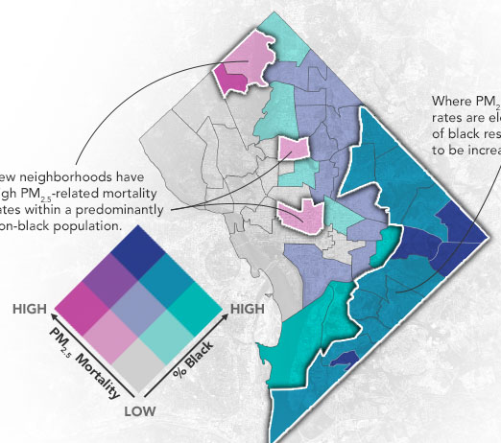
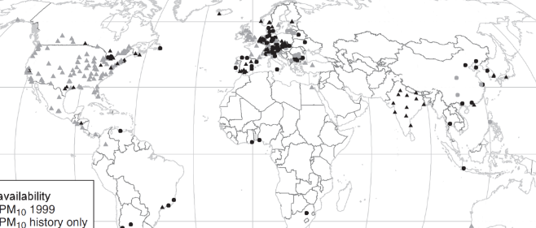
How will TEMPO data improve current research?
2004: Surface air quality monitors, 800,000 premature deaths from urban PM_{2.5} (Cohen et al. 2004)
2010: Global chemical transport model, 3.7 million PM_{2.5} and 700K ozone deaths (Anenberg et al. 2010)
2012-2022: Satellite observations, global chemical transport model, and ground observations combined, ~4 million PM_{2.5} and 200,000 ozone deaths and understanding of urban-scale pollution (Forouzanfar et al. 2016, etc.)
2023 and beyond:
Geostationary satellites, low-cost sensors, mobile monitoring + integration
Temporal variation
Speciation and sources
NO₂ and other pollutants

Slide 3
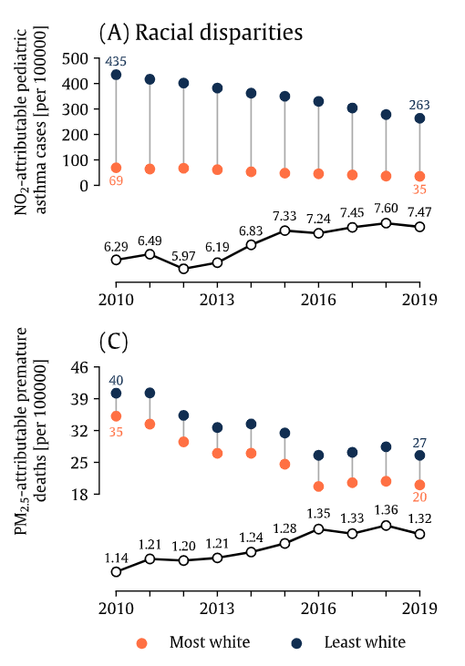

Disparities in pollution-attributable health burdens
PM_{2.5}
NO₂
Led by Dr. Gaige Kerr, under review
3

Slide 4
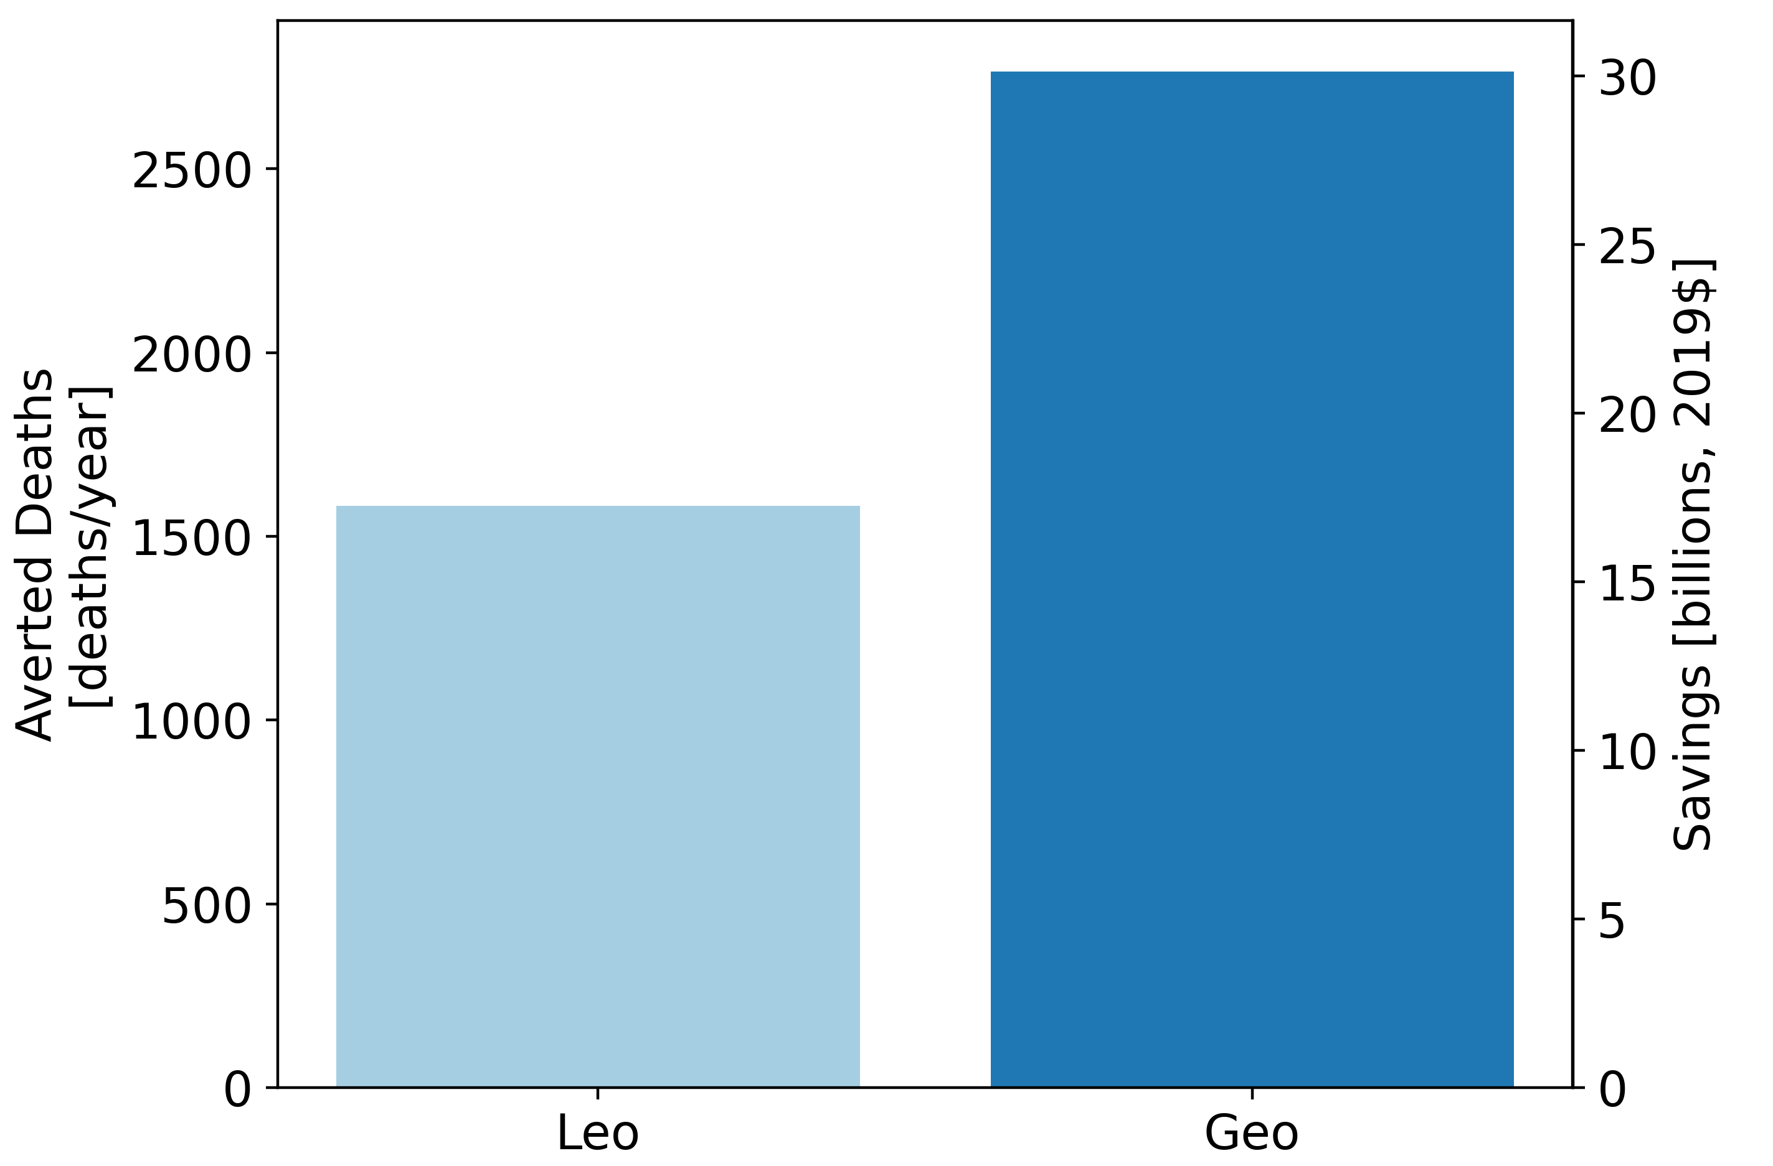
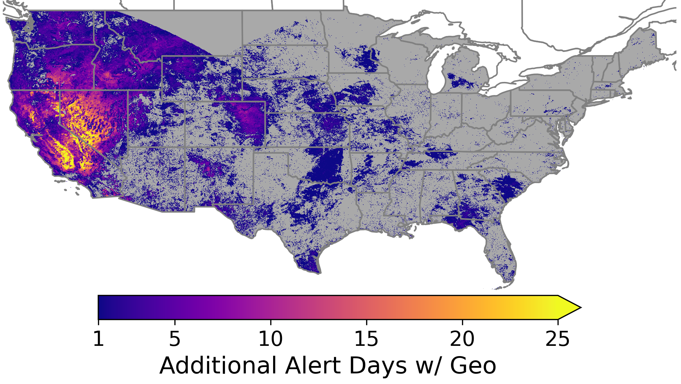



Value of geostationary aerosol observations
Compare the use of GEO vs LEO imager aerosol observations to identify air quality alert days.
Estimate aerosol-attributable health savings from averted emergency-room visits for asthma and premature mortality from cardiovascular and respiratory diseases.
Enhanced benefits of GEO vs. LEO imager observations used in pollution alerts in 2020 across CONUS:
1000 premature deaths averted
$10 billion in health care costs & lost economic productivity saved
Results are preliminary.
Work led by Dr. Kate O’Dell using NOAA Advanced Baseline Imager (ABI) instrument on GOES-R satellite

